Slide 1
Quantification of Protein
Ameer Effat M Elfarash
Dept. of Genetics
Fac. of Agriculture, Assiut Univ.
aelfarash@aun.edu.eg

Slide 2
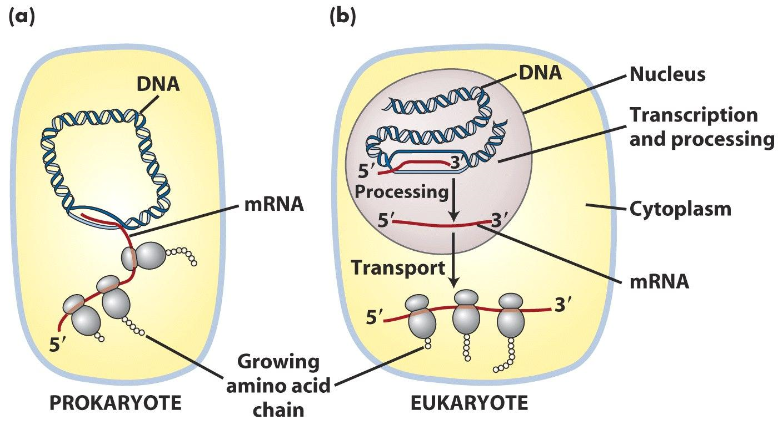

Slide 3
Proteins
Make up about 15% of the cell
Have many functions in the cell
Enzymes
Structural
Transport
Motor
Storage
Signaling
Receptors
Gene regulation
Special functions

Slide 4
Applications
Functional Studies
Enzymatic Assays
Protein-protein interactions
Protein Ligand Interactions
Structural Studies
Protein Crystallography
NMR Structure Determination
Target Proteins for Rational Drug Design
Therapeutic Proteins – Preclinical Studies

Slide 5
Expression analysis
Protein
mRNA
Real-Time PCR

Slide 6
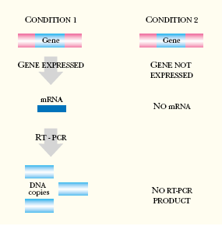
Why RT-PCR?
Gene expression analysis
Cancer research
Drug research
Disease diagnosis and management
Viral quantification
Food testing
Percent GMO food
Animal and plant breeding
Gene copy number
qRT-PCR is used to qualitatively detect gene expression

Slide 7
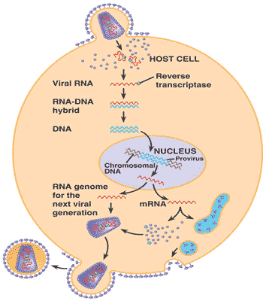

Slide 8
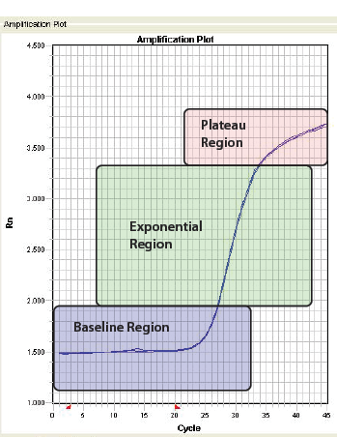
How does PCR work?
Theoretical
Log Target DNA
Cycle Number

Slide 9
Real-Time PCR
Real-Time PCR a specialized technique that allows a PCR reaction to be visualized “in real time” as the reaction progresses.
Quantitative PCR relies on the principal that the quantity of target at the start of the reaction is proportional to amount of product produced during the exponential phase
Greater starting target
Less starting target
∆ Fluorescence
C_{T}
<
C_{T}

Slide 10
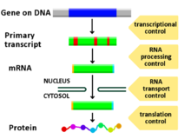
Expression analysis
Protein Level
mRNA

Slide 11
Protein Quantification
Most of proteins are colorless
In most cases, a mixture of several proteins or many proteins
Bacterial DNA
Plasmid DNA
Bacterial protein
Target protein

Slide 12
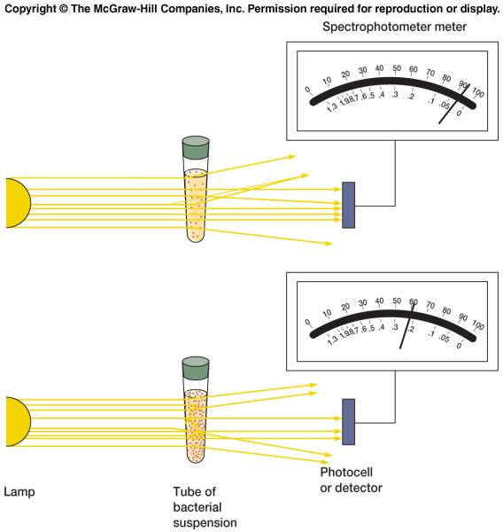
Absorbance

Slide 13
Quantification of Protein
UV absorption
Colorimetric methods
Biuret
Lowry
Bradford
Other Methods

Slide 14
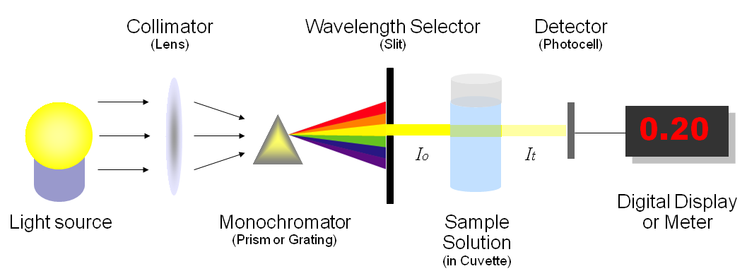
UV Absorption Method
The amino acids tryptophan, tyrosine and phenylalanine absorb light in the UV wavelength (280 nm)
Since the absorption is proportional to concentration, this is a useful way to quantitate protein concentration (for proteins containing Trp)

Slide 15
Disadvantages
Advantages:
Rapid
Non interference from ammonium sulfate.
Non destructive.
If some proteins do not contain these amino acids, it will not absorb UV light.
Turbidity (cloudiness in solution) is a problem.
Nucleic acids (DNA, RNA) contaminant and phenolic acids will also absorb UV light.

Slide 16
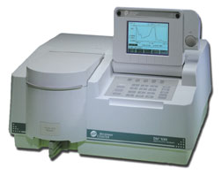
Colorimetric Methods
we can modify the protein sample with appropriate reagents so as to produce a color reaction and measure protein concentration using a spectrophotometer.

Slide 17
Advantages of Colorimetric Methods
1. Cheap
2. Not contaminating absorbance from nucleic acids!
Biuret
Lowry
Bradford

Slide 18
2.5 5 10 15 20 25 µg/mL

Slide 20
Protein Quantification Methods
Assay method | Useful range | Comments
NanoOrange assay | 100ng/ml to 10ug/ml | Samples can be read up to six hours later without any loss in the sensitivity Low protein to protein signal variability Detection not influenced by reducing agents or nucleic acid
BCA method (Cu reduction) | 0.5ug/ml to 1.5mg.ml | Samples must be read within 10 mins Not compatible with reducing agents
Bradford assay (dye binding) | 1ug/ml to 1.5 mg/ml | Protein precipitates over time High protein to protein signal variability Not compatible with detergents
Lowry assay | 1ug/ml to 1.5mg.ml | Lengthy, multi-step procedure Not compatible with detergents, carbohydrates or reducing agents
Absorbance at 280nm | 50ng/ml to 2mg/ml | High protein to protein signal variability Detection influenced by nucleic acids and other UV absorbing contaminants

Slide 21
Protein Assays Sensitivity
A₂₈₀ (20 to 3000 ug/ml)
A₂₀₅ (1 to 10 ug/ml)
Fluorescence (5 to 50 ug/ml)
Lowry method (5 to 100 ug/ml)
Bradford method (10 to 100 ug/ml)
BCA (bicinchoninic acid) method (0.5ug/ml)
Notes:
Quantitative and All depend on standard curves
Non-destructive:
A280 (20 to 3000 ug/ml) trp and tyr, variable in different proteins, other things absorb eg nucleic acids
A205 (1 to 10 ug/ml) peptide bond, many other things eg buffers absorb here
Fluorescence (5 to 50 ug/ml) UV excitation leads to trp fluorescence, requires Trp and fluorometer
Destructive:
Lowry method (1 to 20 ug/200ul), Folin-Ciocalteu phenol reagent binds Tyr with CuTartrate and gives purple color; buffers, reducing agents, detergents, sugars interfere.
Bradford method (1 to 10 ug/100ul), coomassie dye binds to proteins, (Arg and aromatics); glycerol, detergents mercaptoethanol, buffers interfere.
BCA (bicinchoninic acid) method (0.5ug/ml), more stable than Lowry, but reducing agents interfere.

Slide 22
Tools used for protein analysis
Without
Electrophorasis
Electrophorasis
Native PAGE
Native Gradient PAGE
Urea PAGE
SDS PAGE
SDS Gradient PAGE
IEF
2D PAGE
Western Blot
Cloning
Site-directed mutagenesis
protein tags
Protein structures
Proteomics
Protein Sequencing
Protein-protein interactions

Slide 23
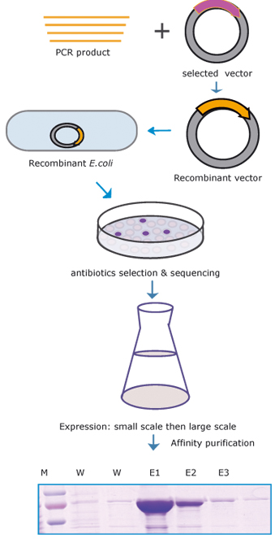
Cloning
Why?
Obtain pure protein
Make large quantities to facilitate study

Slide 24
Functional Study
DNA binding
enzyme activity
stability
etc.,

Slide 25
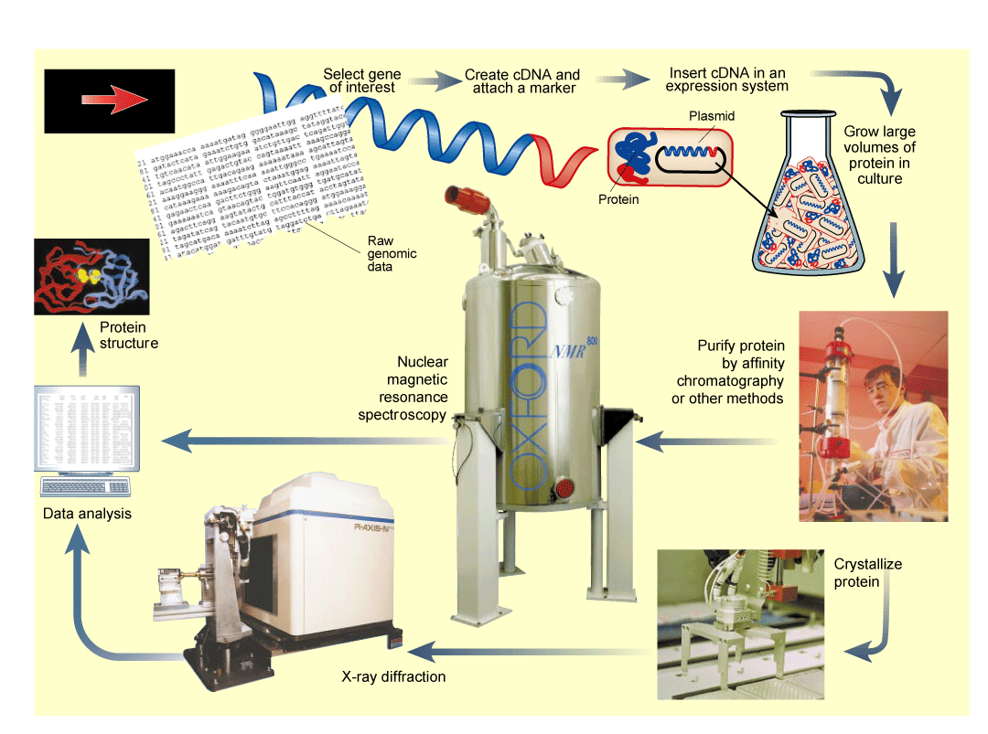
Protein structures

Slide 26
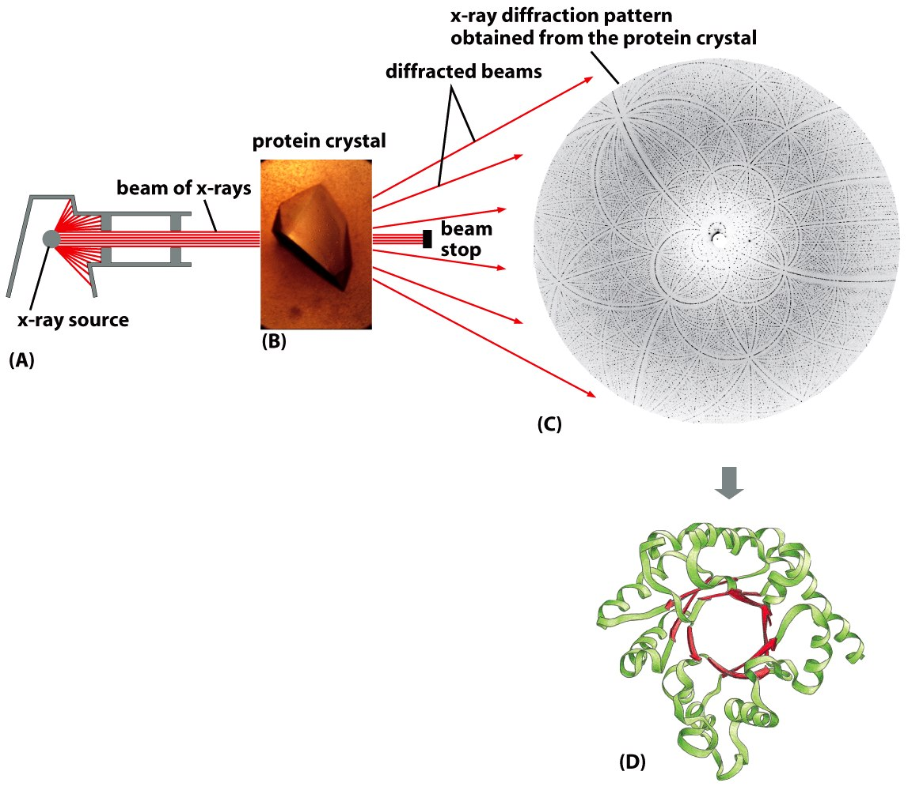
The diffraction of X-ray by protein crystals can reveal a protein’s exact structure

Slide 27
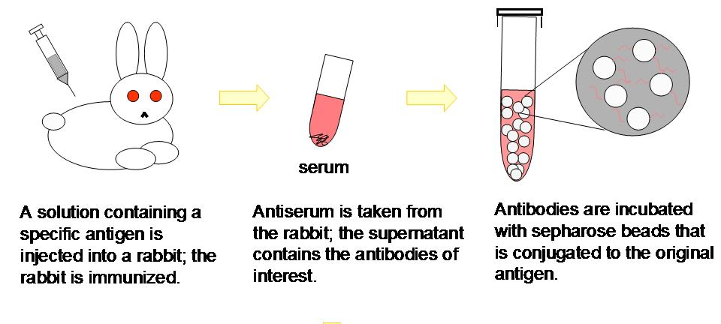
Produce Antibodies

Slide 28
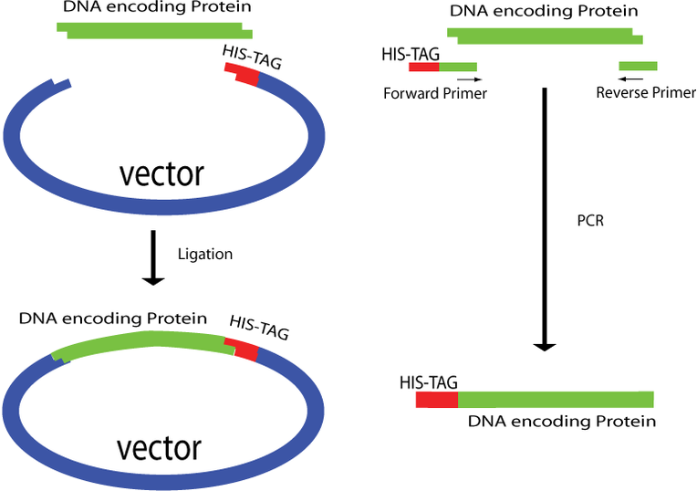
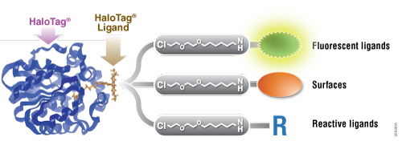
Protein tags

Slide 29
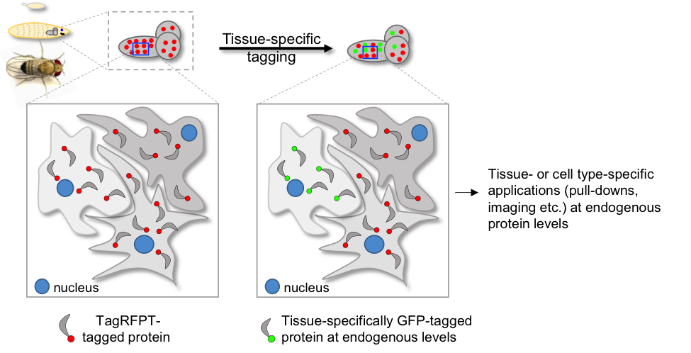

Slide 30
Site-directed mutagenesis

Slide 31
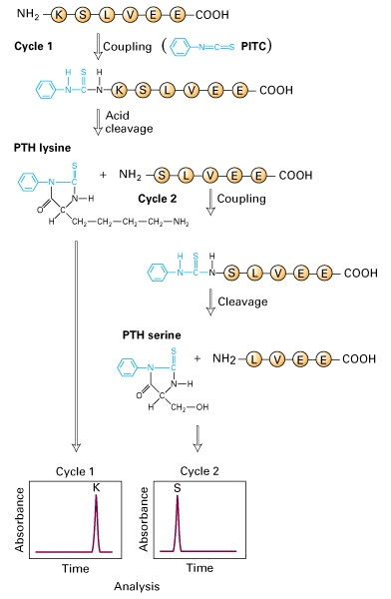
Protein Sequencing

Slide 32
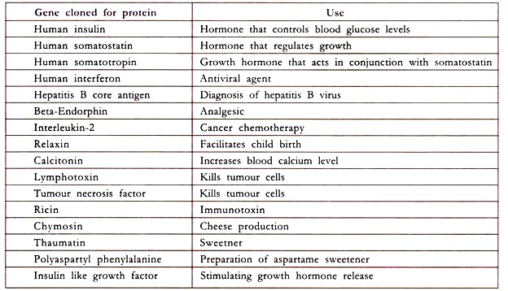
Commercial Uses

