Slide 1
From Gene to Protein
(an overview)
Ameer Effat M. Elfarash
Dept. of Genetics
Fac. of Agriculture, Assiut Univ.
aelfarash@aun.edu.eg

Slide 2
DEFINITION
Gene cloning is a set of experimental methods in molecular biology that are used to assemble recombinant DNA molecules and to direct their replication within host organisms.
The use of the word cloning refers to the fact that the method involves the replication of a single DNA molecule starting from a single living cell to generate a large population of cells containing identical DNA molecules.

Slide 3
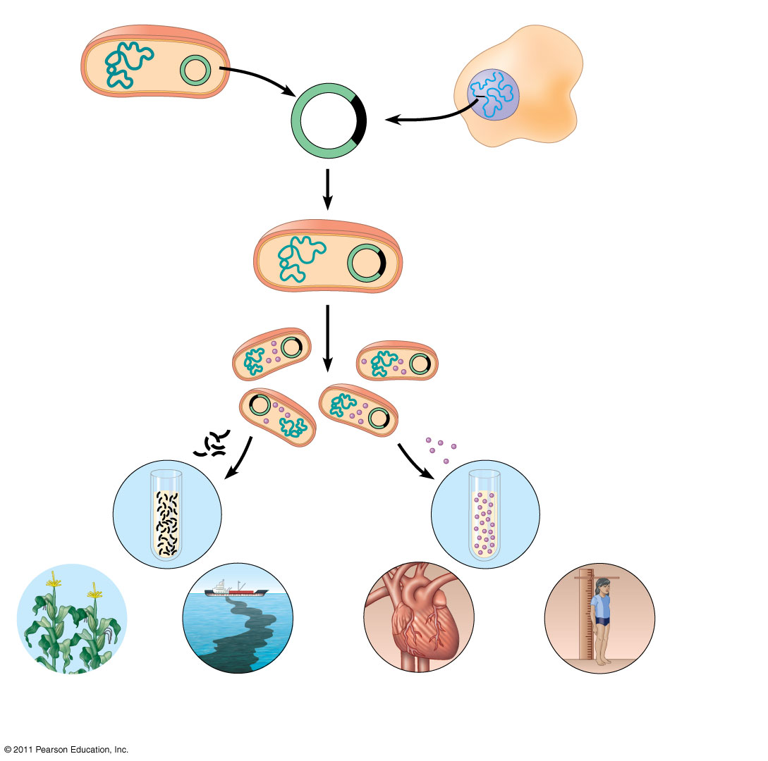
Bacterium
1
Gene inserted into
plasmid
Cell containing gene
of interest
Bacterial
chromosome
Plasmid
Gene of
interest
Recombinant
DNA (plasmid)
DNA of
chromosome
(“foreign” DNA)
2
Plasmid put into
bacterial cell
Recombinant
bacterium
3
Host cell grown in culture to
form a clone of cells containing
the “cloned” gene of interest
Gene of
interest
Protein expressed from
gene of interest
Copies of gene
Protein harvested
4
Basic research
and various
applications
Basic
research
on gene
Basic
research
on protein
Gene for pest
resistance inserted
into plants
Gene used to alter
bacteria for cleaning
up toxic waste
Protein dissolves
blood clots in heart
attack therapy
Human growth
hormone treats
stunted growth

Slide 4
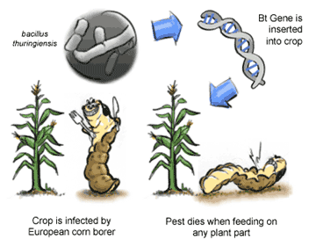
What is transformation used for?
Agricultural
  Genes coding for traits such as frost, pest or drought resistance can be genetically transformed into plants

Slide 5
Medical
  Production of human proteins to treat genetic diseases
Protein | Disease/Disorder
Human insulin | Diabetes mellitus
Human Growth Hormone | Deficiency in children
Erythropoietin | Anemia
DNase I | Cystic fibrosis
Human antibody blocker | Asthma

Slide 6
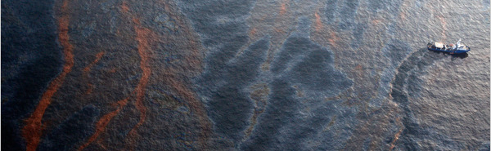
Environmental
  Bacteria can be genetically transformed with genes enabling them to digest oil spills or remove pollutants from the environment

Slide 7
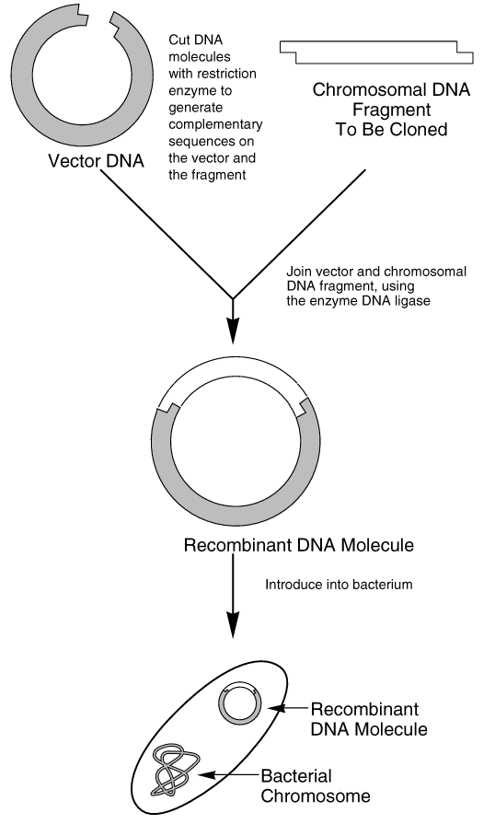
CLONING PROCESS

Slide 8
CLONING PROCESS
Amplify Target Gene
Cut Target Gene and Plasmid
Ligation
Transformation
Cellular Screening
Protein Expression

Slide 9
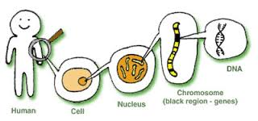
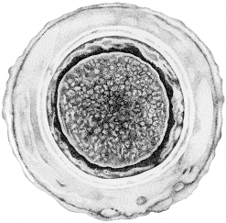
STEP 1. DNA isolation and PCR
DNA can be very large, therefore for study, we look at small sections of it, then piece the sections together

Slide 10
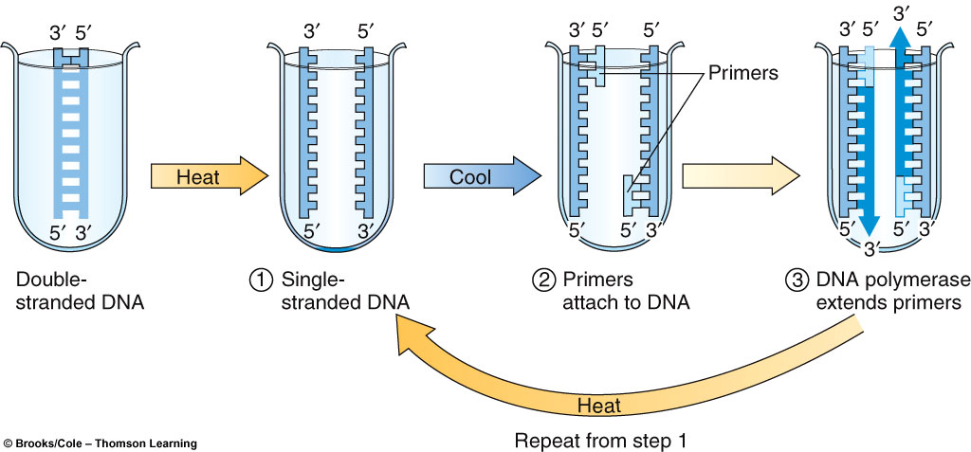
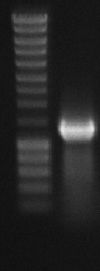
Polymerase Chain Reaction
(PCR)
PCR is used to:
  Specifically amplify the target gene
  Introduce the recognition site of the Restriction enzyme

Slide 11
5’
3’
PCR
RE

Slide 12
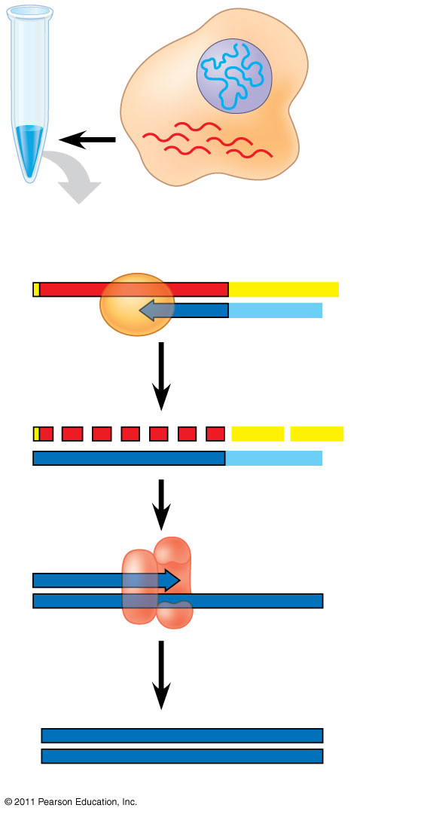
DNA in
nucleus
Reverse transcriptase
mRNAs in
cytoplasm
Reverse
transcriptase
Produce complementary DNA (cDNA) from an RNA template.
mRNA
Poly-A tail
5′
A A A A A A
3′
3′
T T T T T
5′
DNA
strand
Primer
5′
A A A
A A A
3′
3′
T T T T T
5′
5′
3′
3′
5′
DNA
polymerase
5′
3′
3′
5′
cDNA

Slide 13
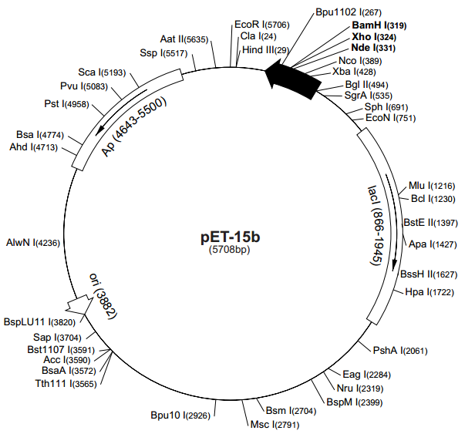
Plasmid DNA isolation
To introduce a gene of interest into bacteria.
Hallmarks:
- Multi cloning site.
- Selection marker.
- Promoter.

Slide 14
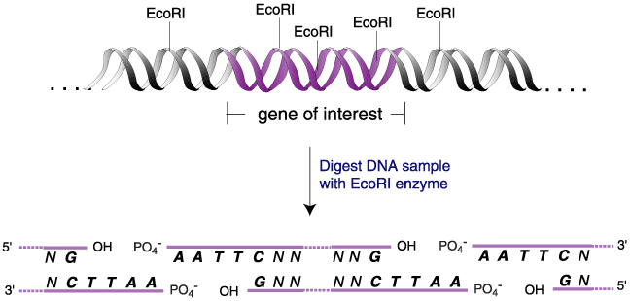
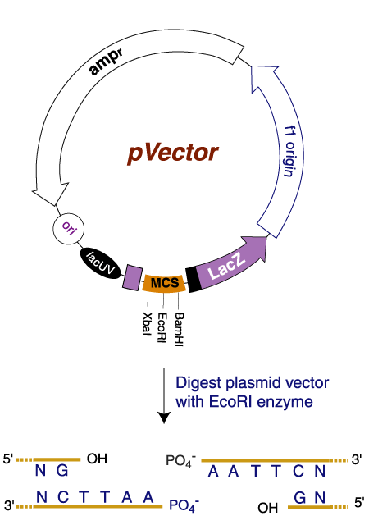
STEP 2. DIGESTION

Slide 15
Restriction Digestion
Nde 1
Bam H1
Nde 1
Vector (pET 15b)
Bam H1
Selection Marker

Slide 16
STEP 3. LIGATION
Nde 1
Bam H1
Vector
Insert (PCR product)
Vector
T7 Promoter
6 His tag
Nde 1
Selection Marker
Gene of Interest
Bam H1

Slide 17
STEP 4. TRANSFORMATION
The process of transferring exogenous DNA into cells is call “transformation”
There are basically two general methods:
    chemical method utilizing CaCl2
    electroporation
Cell membrane
Bacterial
chromosomal DNA
*plasmids*

Slide 18
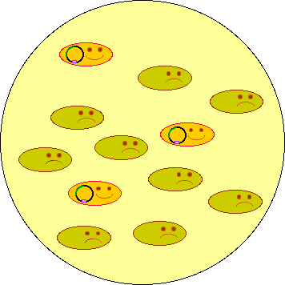
STEP 5. GROWTH ON AGAR PLATES
Growing Culture
Spread transformed bacterial cells on the LB plate with selection drug and grow overnight.

Slide 19
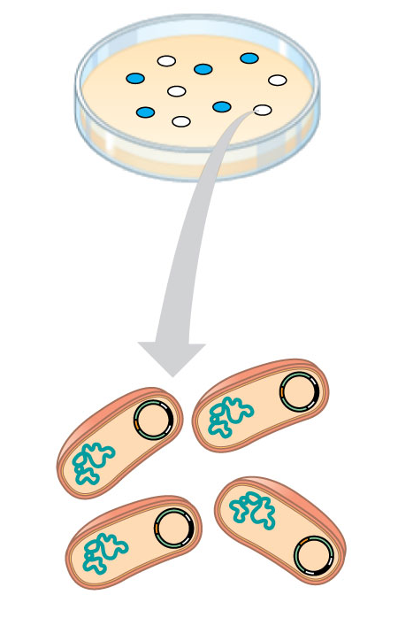
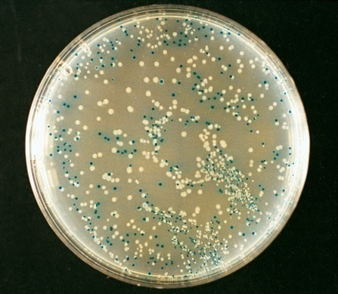
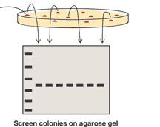
Detection of the right cloning
Screening with PCR
Blue white screening

Slide 20
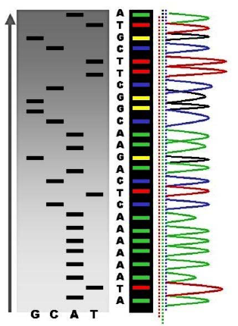
Conformation with DNA Sequencing

Slide 21
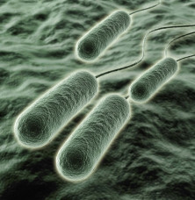
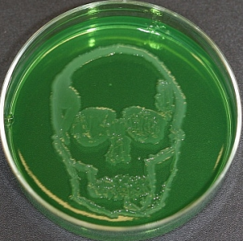
What are we doing?
We will transform bacteria (E. coli), giving it the ability to produce the Pyocin S5 protein from Pseudomonas aeruginosa

Slide 22
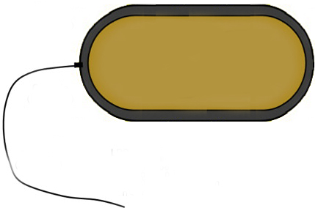
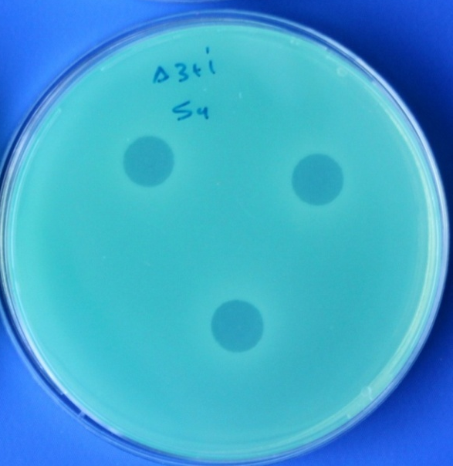
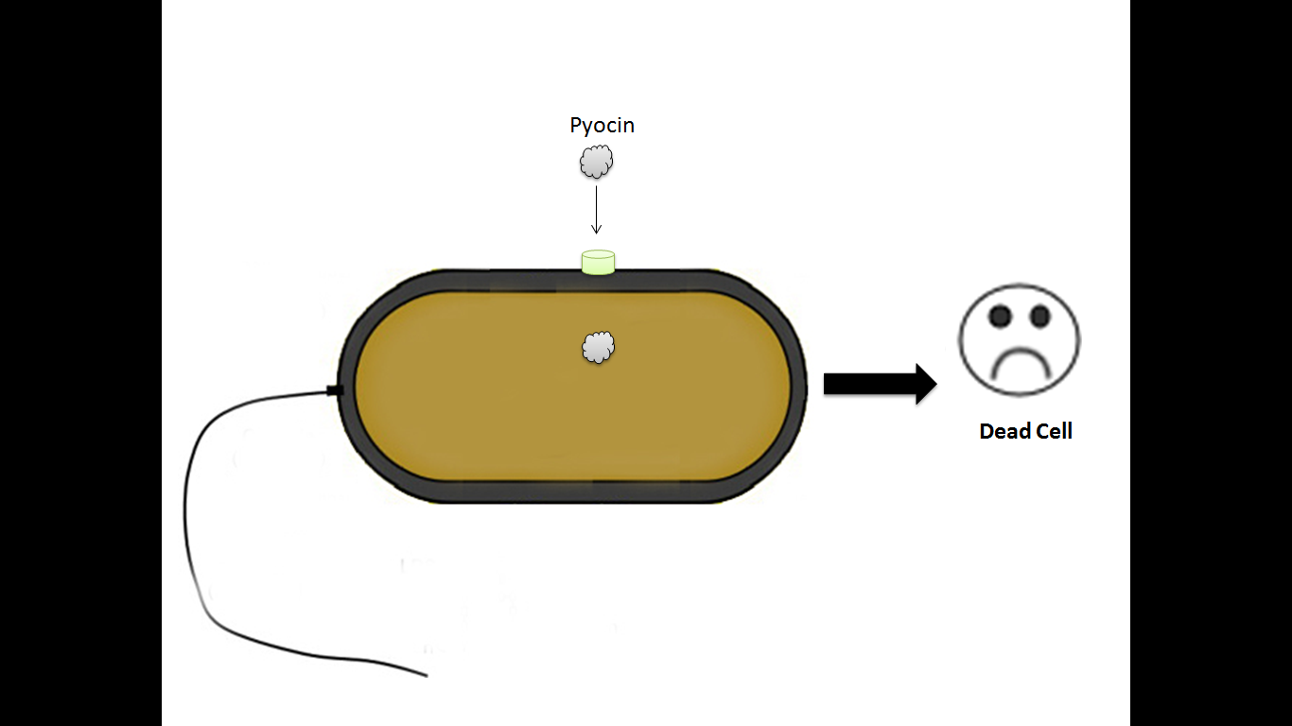
Pyocin S5 of PAO1 strain
PA0985
S5
S5
Pore-forming

Slide 23
Primers Amplifying Target DNA
Cloning primers of Pyocin S5 gene
GGAATTCCATATGTCCAATGACAACGAAGTACCTGG | Fw | 60 | 1848 | Nde1
CGGGATCCTTGAGCTTTAAATACTATTGGGC | Rv | 54.8 |  | BamH1

Slide 24


