Slide 1
Gene cloning
(an overview)
Ameer Effat M. Elfarash
Dept. of Genetics
Fac. of Agriculture, Assiut Univ.
aelfarash@aun.edu.eg

Slide 2
DEFINITION
Gene cloning is a set of experimental methods in molecular biology that are used to assemble recombinant DNA molecules and to direct their replication within host organisms.

Slide 3
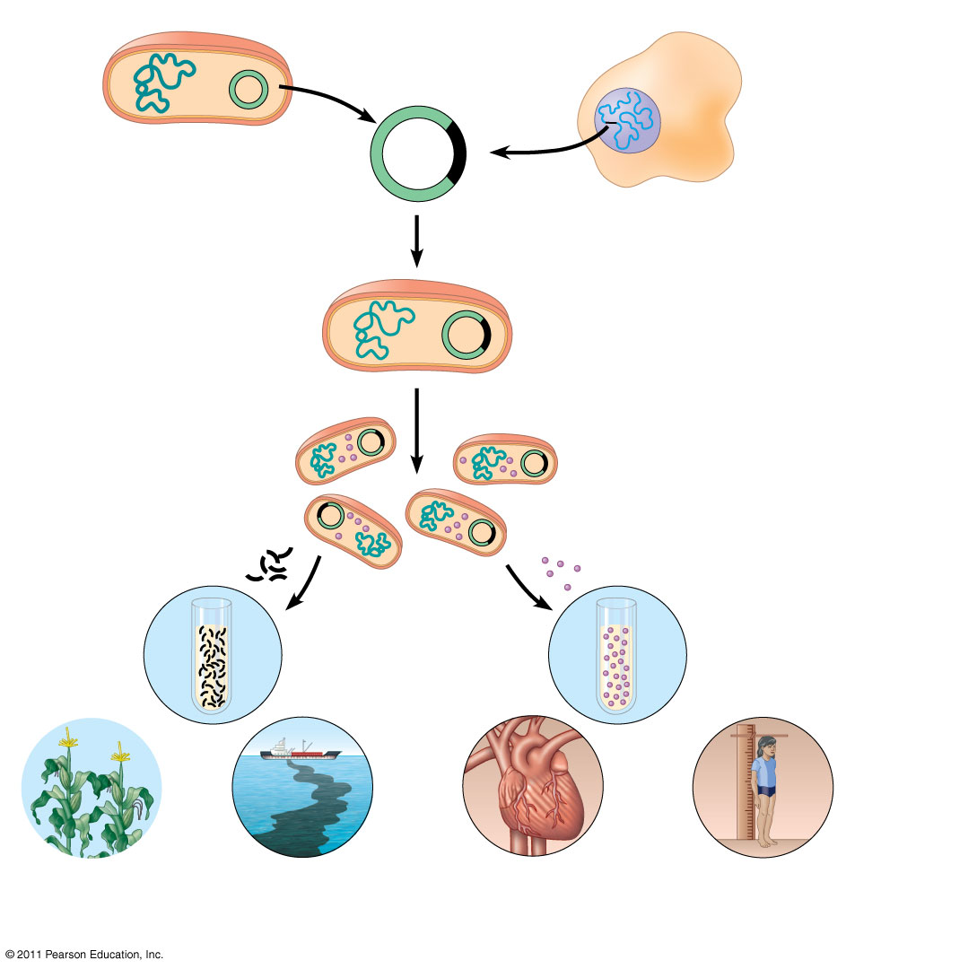
Bacterium
1
Gene inserted into plasmid
Cell containing gene of interest
Bacterial chromosome
Plasmid
Gene of interest
Recombinant DNA (plasmid)
DNA of chromosome (“foreign” DNA)
2
Plasmid put into bacterial cell
Recombinant bacterium
3
Host cell grown in culture to form a clone of cells containing the “cloned” gene of interest
Gene of interest
Protein expressed from gene of interest
Copies of gene
Protein harvested
4
Basic research and various applications
Basic research on gene
Basic research on protein
Gene for pest resistance inserted into plants
Gene used to alter bacteria for cleaning up toxic waste
Protein dissolves blood clots in heart attack therapy
Human growth hormone treats stunted growth

Slide 4
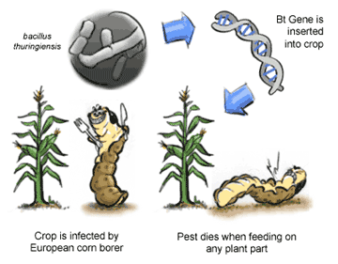
What is cloning used for?
Agricultural
Genes coding for traits such as frost, pest or drought resistance can be genetically transformed into plants

Slide 5
Medical
Production of human proteins to treat genetic diseases
Protein | Disease/Disorder
Human insulin | Diabetes mellitus
Human Growth Hormone | Deficiency in children
Erythropoietin | Anemia
DNase I | Cystic fibrosis
Human antibody blocker | Asthma

Slide 6
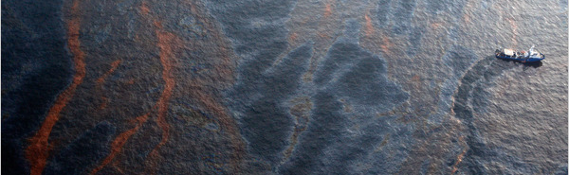
Environmental
Bacteria can be genetically transformed with genes enabling them to digest oil spills or remove pollutants from the environment

Slide 7
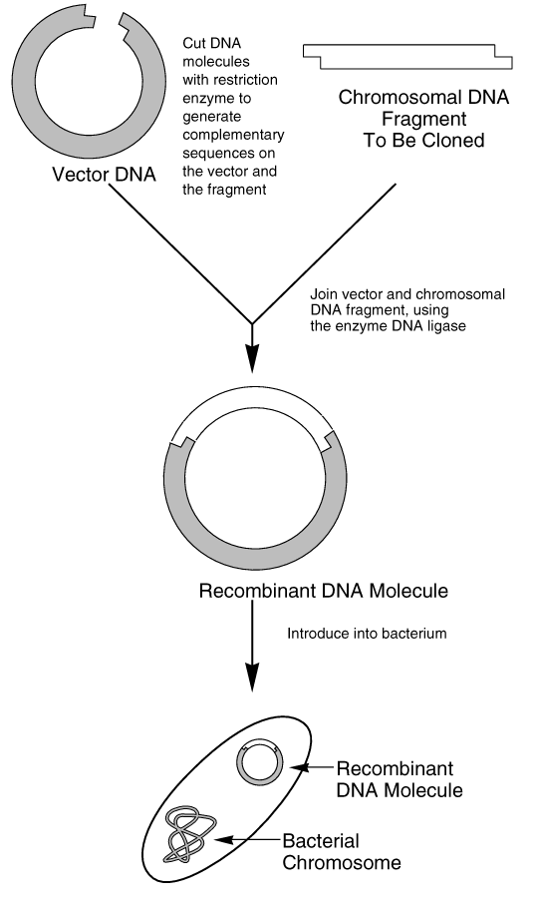
CLONING PROCESS

Slide 8
CLONING PROCESS
DNA isolation and Target Gene Amplification
Cut Target Gene and Plasmid
Ligation
Transformation
Cellular Screening
Protein Expression

Slide 9
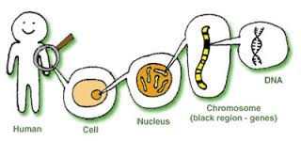
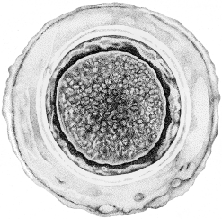
STEP 1. DNA isolation and PCR
DNA can be very large, therefore for study, we look at small sections of it, then piece the sections together

Slide 10
Polymerase Chain Reaction (PCR)
PCR is used to:
Specifically amplify the target gene
Introduce the recognition site of the Restriction enzyme

Slide 11
Plasmid DNA isolation
To introduce a gene of interest into bacteria.
Hallmarks:
- Multi cloning site.
- Selection marker.
- Promoter.

Slide 12
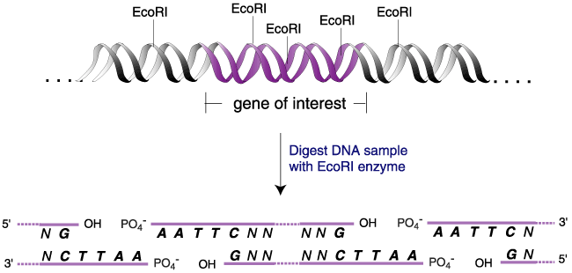
STEP 2. DIGESTION

Slide 13
Digestion with Restriction Enzymes
Nde 1
Bam H1
Nde 1
Vector (pET 15b)
Bam H1
Selection Marker

Slide 14
5’
3’
PCR
RE

Slide 15
STEP 3. LIGATION
Bam H1
Nde 1
Bam H1
Nde 1
Vector
Insert (PCR product)
Vector
Nde 1
Nde 1
ligation
Gene of Interest
Bam H1
Bam H1

Slide 16
STEP 4. TRANSFORMATION
The process of transferring exogenous DNA into cells is call “transformation”
There are basically two general methods:
chemical method utilizing CaCl2
electroporation
Cell membrane
Bacterial
chromosomal DNA
*plasmids*

Slide 17
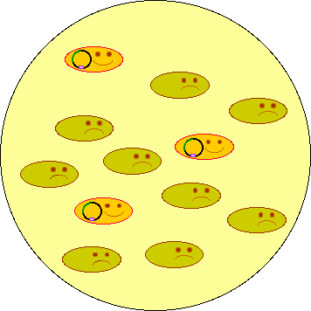
STEP 5. GROWTH ON AGAR PLATES
Growing Culture
Spread transformed bacterial cells on the LB plate with selection drug and grow overnight.

Slide 18
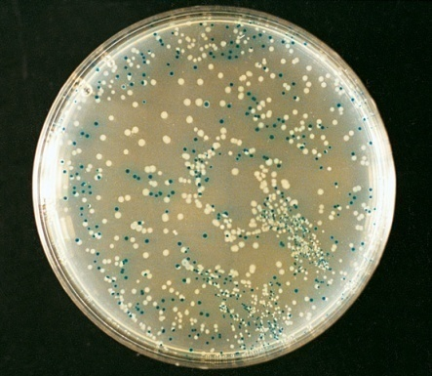
Detection of the right cloning
Screening with PCR
Blue white screening

Slide 19
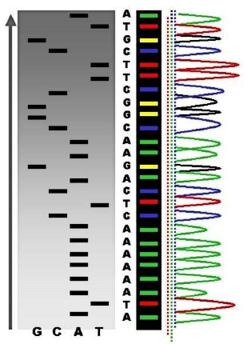
Conformation with DNA Sequencing

Slide 20
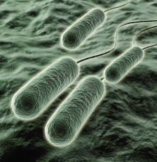
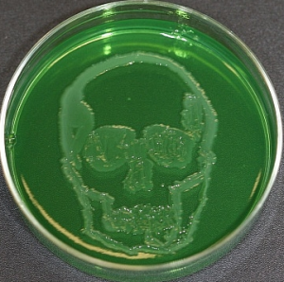
What are we doing?
We will transform bacteria (E. coli), giving it the ability to produce the Pyocin S5 protein from Pseudomonas aeruginosa

Slide 21
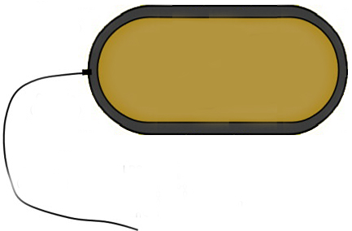
Pyocin S5 of PAO1 strain
PA0985
S5
S5
Pore-forming

Slide 22
Primers Amplifying Target DNA
Cloning primers of Pyocin S5 gene
GGAATTCCATATGTCCAATGACAACGAAGTACCTGG | Fw | 60 | 1848 | Nde1
CGGGATCCTTGAGCTTTAAATACTATTGGGC | Rv | 54.8 |  | BamH1

